Slide 1
19CS2109
COMPUTER NETWORKS AND SECURITY

Slide 2
Network Layer Design Issues Routing Algorithms
Session-18,19,20

Slide 3
Network Layer Design Isues
Store-and-Forward Packet Switching
Services Provided to the Transport Layer
Implementation of Connectionless Service
Implementation of Connection-Oriented Service
Comparison of Virtual-Circuit and Datagram Subnets

Slide 4
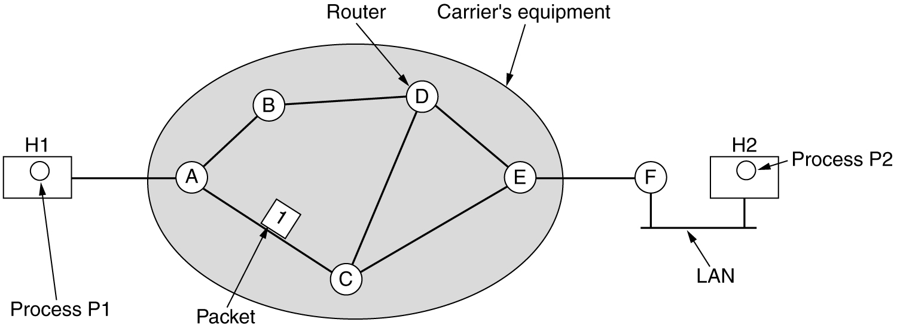
Store-and-Forward Packet Switching
The environment of the network layer protocols.
fig 5-1

Slide 5
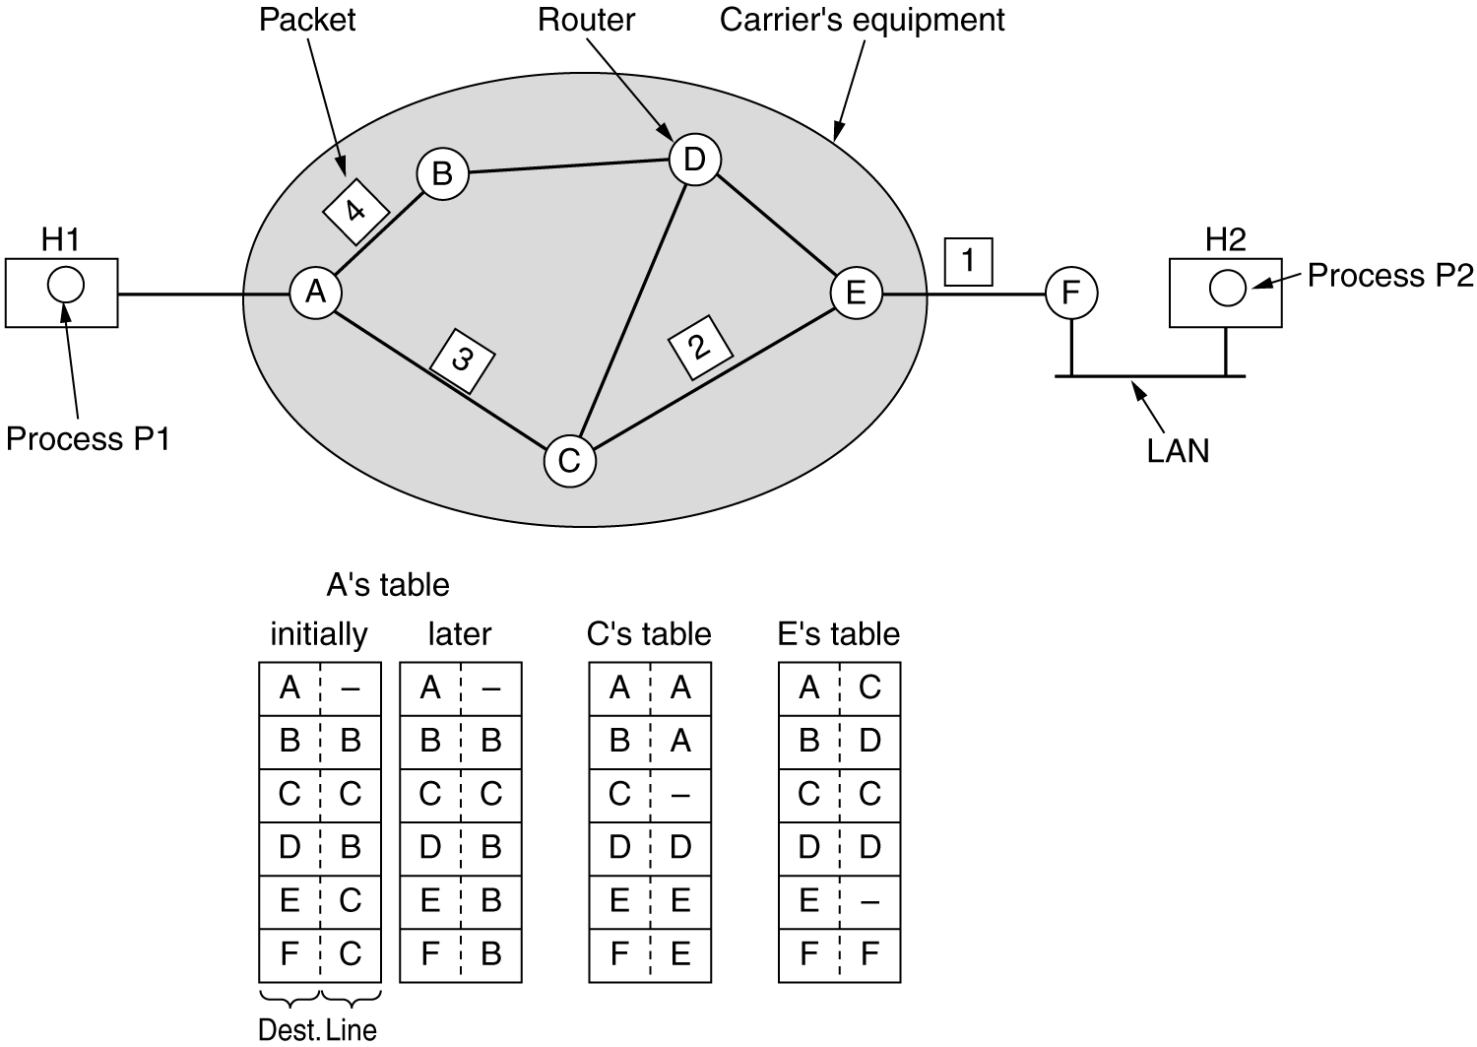
Implementation of Connectionless Service
Routing within a diagram subnet.

Slide 6
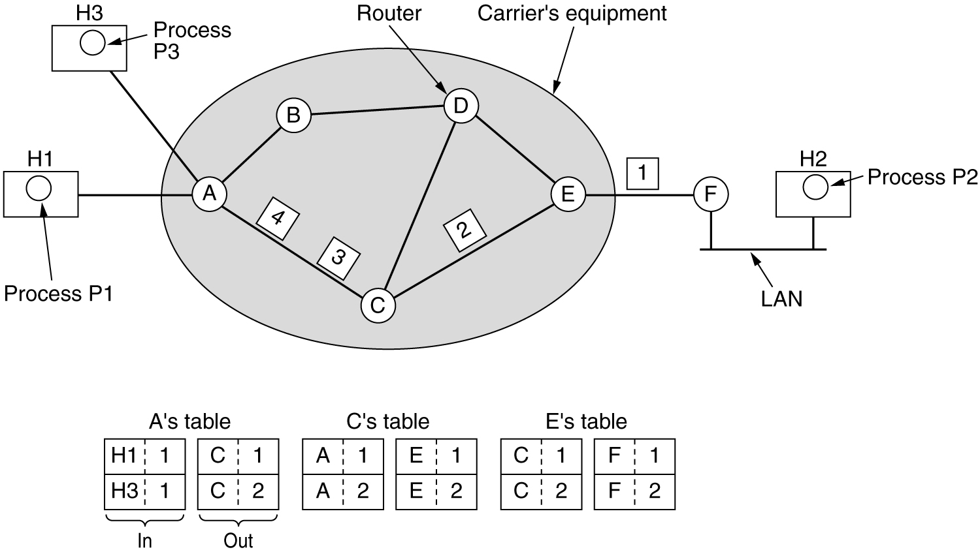
Implementation of Connection-Oriented Service
Routing within a virtual-circuit subnet.

Slide 7
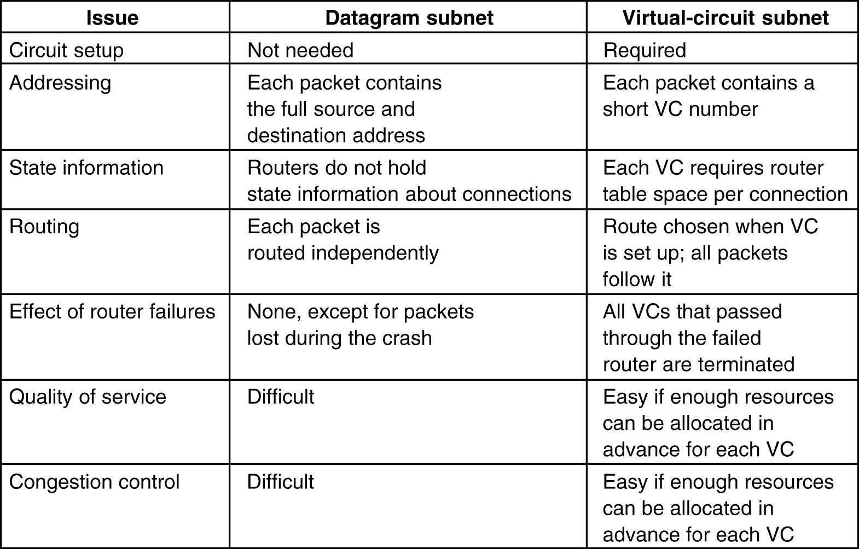
Comparison of Virtual-Circuit and Datagram Subnets
5-4

Slide 8
Routing Algorithms
The Optimality Principle
Shortest Path Routing
Flooding
Distance Vector Routing
Link State Routing
Hierarchical Routing
Broadcast Routing
Multicast Routing
Routing for Mobile Hosts
Routing in Ad Hoc Networks

Slide 9
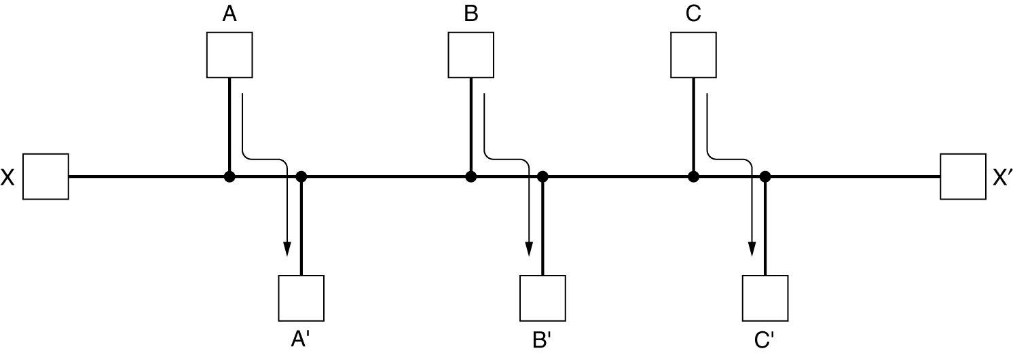
Routing Algorithms (2)
Conflict between fairness and optimality.

Slide 10
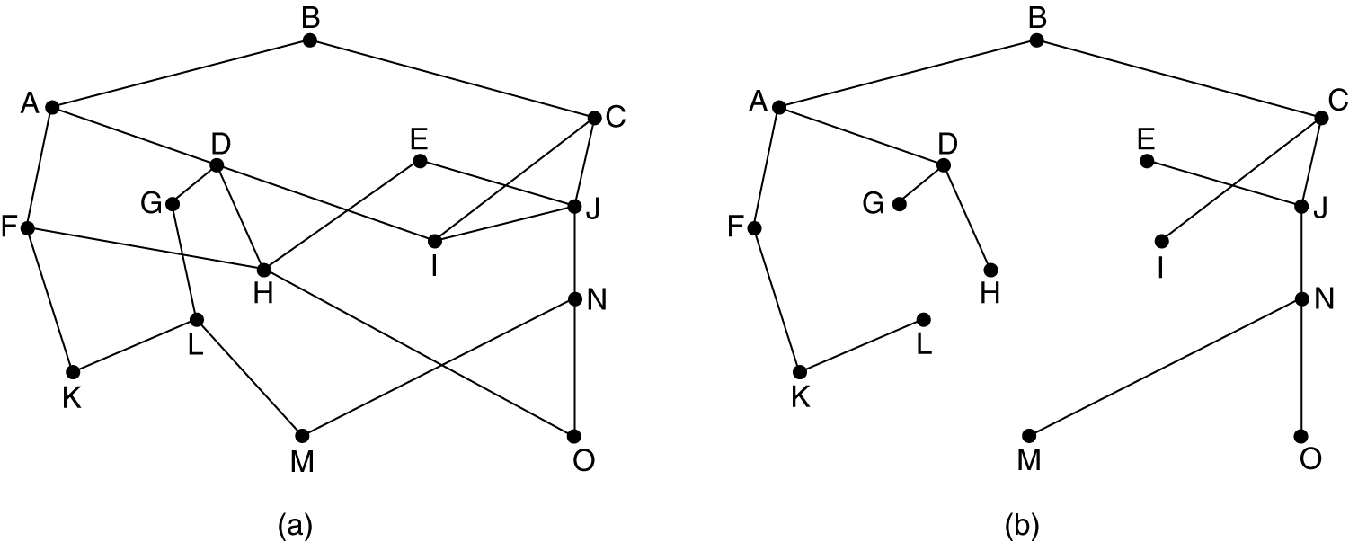
The Optimality Principle
(a) A subnet. (b) A sink tree for router B.

Slide 11
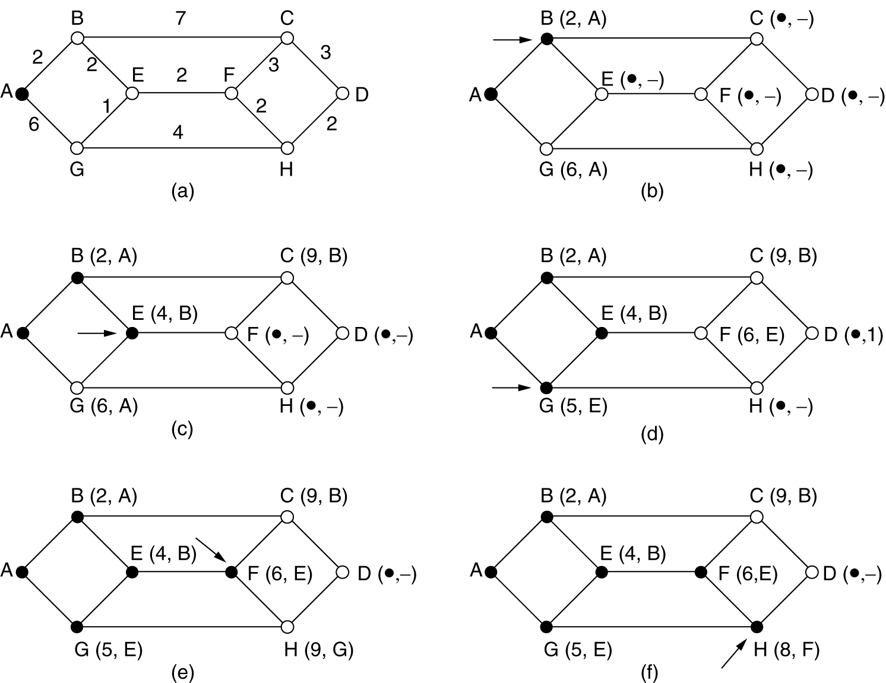
Shortest Path Routing
The first 5 steps used in computing the shortest path from A to D. The arrows indicate the working node.

